Slide 1
Employee Management System
Java Full Stack Project
Frontend: HTML, CSS, JavaScript ,React
Backend: Java (Spring Boot)
``Database: MONGO DB
NAME :N.SAI NIKHIL
REG NO:43612037

Slide 2
ABSTRACT
The Employee Management System (Employee Attendance System) is a web-based application designed to automate the process of managing employee information and tracking attendance. It allows administrators to add, update, and monitor employee details efficiently, reducing manual work and improving accuracy.

Slide 3
Existing System
In the existing , attendance and employee data are maintained manually on paper or spreadsheets. This leads to issues such as data inconsistency, time consumption, difficulty in record retrieval, and lack of transparency.

Slide 4
Proposed System
The proposed system is a web application that digitizes employee data management and automates attendance tracking. It allows employees to mark attendance online, and administrators can generate reports, manage roles, and analyze performance through a centralized dashboard.

Slide 5
ADVANTAGES
Reduces manual effort and paperwork
Improves data accuracy and security
Easy access to employee records
Automated report generation
Time-saving and efficient monitoring

Slide 6
DISADVANTAGES
Requires stable internet connection
Initial setup and maintenance cost
Technical knowledge required for handling the system

Slide 7
Hardware Requirements
Processor: Intel i3 or above
RAM: Minimum 4 GB
Hard Disk: 500 GB or more
Display: 1024x768 resolution or higher

Slide 8
Software Requirements
Operating System: Windows / Linux
Frontend: HTML, CSS, JavaScript
Backend: Java (Spring Boot)
Database: MySQL
Tools: Eclipse / IntelliJ IDEA, XAMPP / MySQL Workbench, Browser (Chrome/Edge)

Slide 9
Modules
Admin Module
Employee Module
Attendance Module
Report Generation Module
Authentication Module

Slide 10
Module Description
Admin Module: Manages employees, departments, and system settings.
Employee Module: Allows employees to view details and mark attendance.
Attendance Module: Tracks daily attendance records automatically.
Report Generation Module: Generates reports for HR and management.
Authentication Module: Ensures secure login and access control.

Slide 11
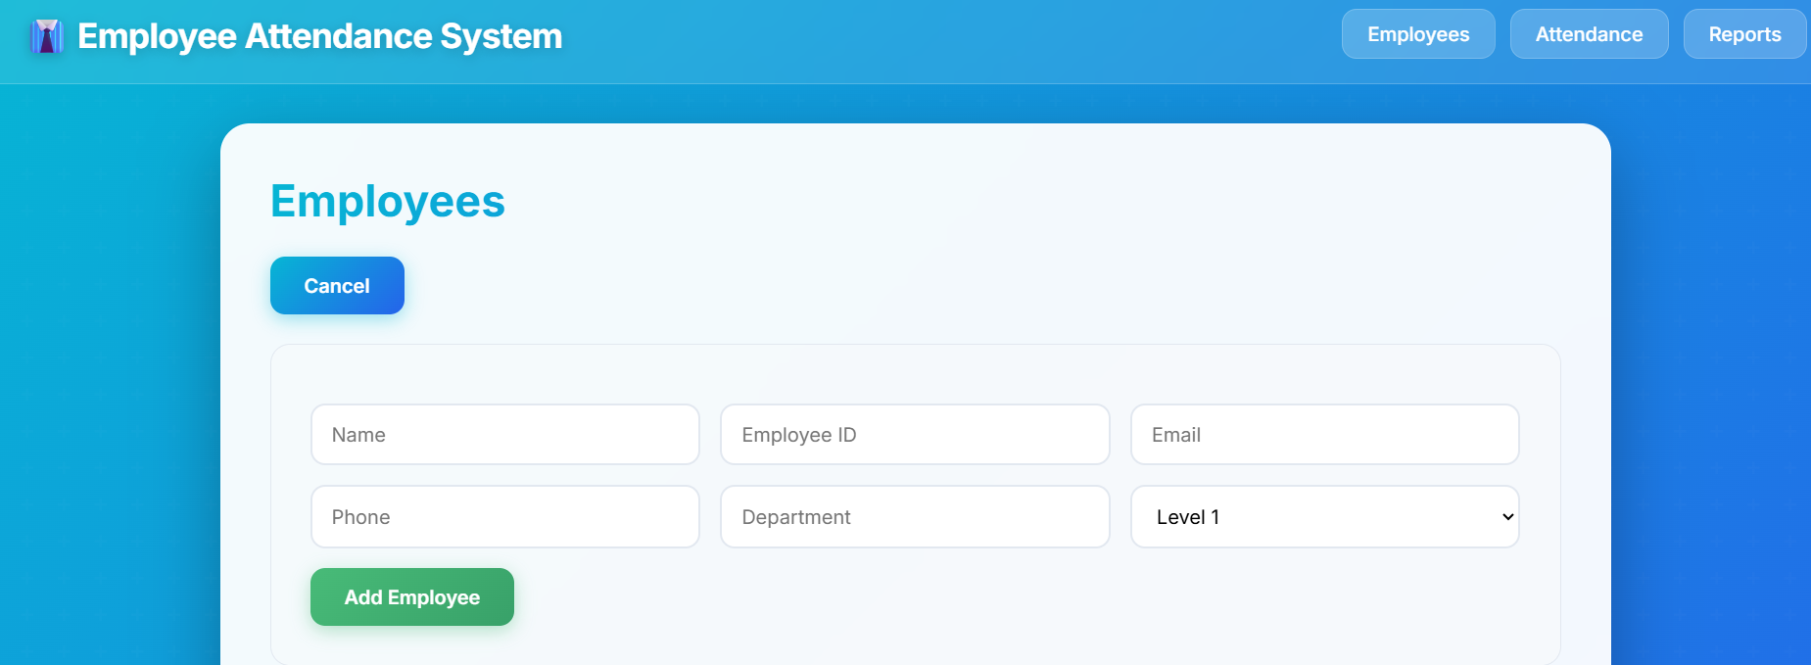
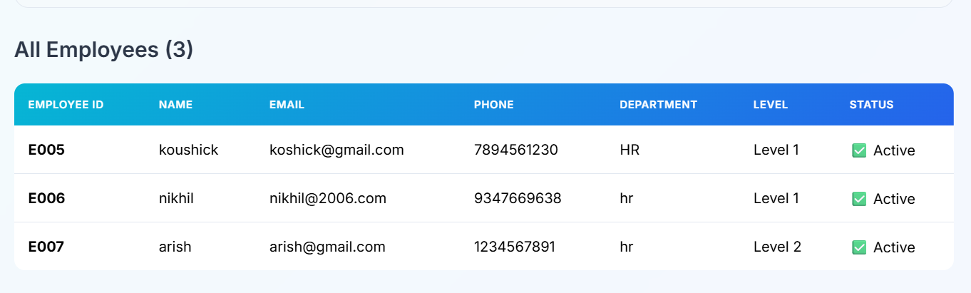
Sample Output (Screenshot)

Slide 12
Conclusion
The Employee Management System (Employee Attendance System) successfully streamlines employee data handling and attendance tracking. It enhances efficiency, reduces errors, and provides a reliable platform for managing workforce information digitally.

